Slide 1
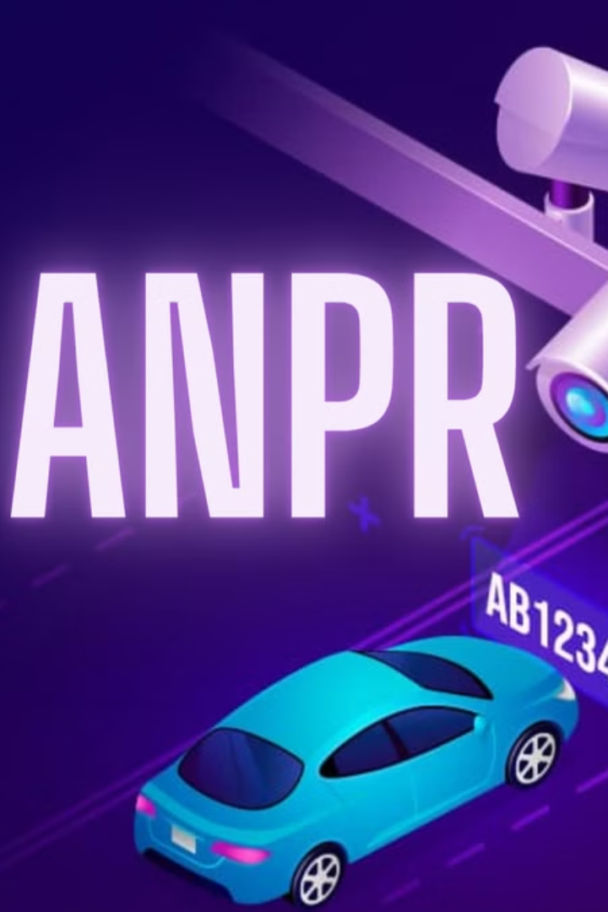
Automatic Number Plate Recognition (ANPR) System
Student Name: Ayush Kumar Singh
Sec: DS1
Roll Number: 35
Sem: 5th Sem
Guide Name: Dr. Vikas Tripathi
Project Team ID: G10

Slide 2
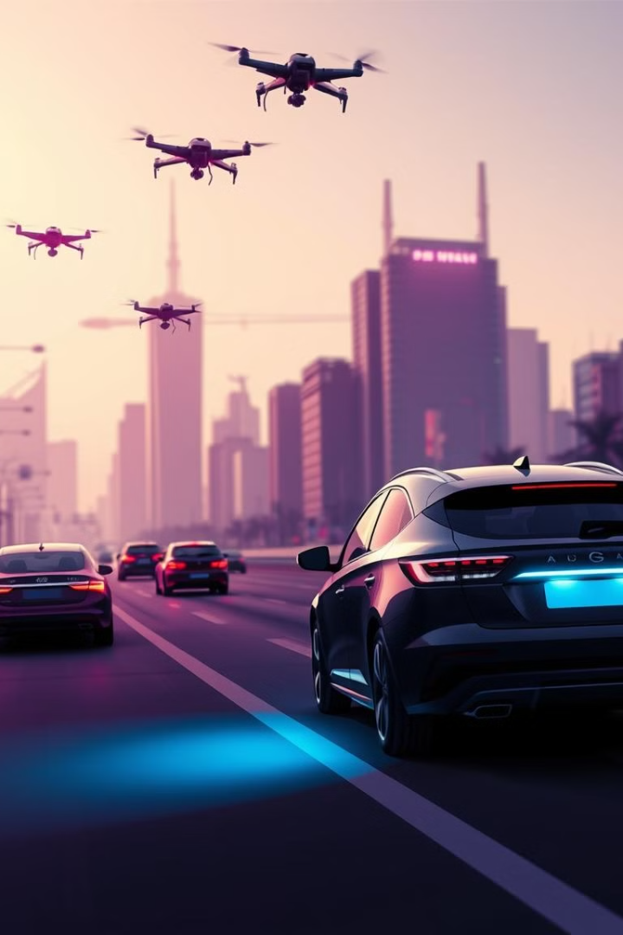
Automatic Number Plate Recognition (ANPR) System
Automatic Number Plate Recognition (ANPR), a critical technology revolutionizing various industries. We'll explore the evolution of ANPR, its challenges, and the potential of deep learning to address them. We'll also delve into the methodology of developing an ANPR system and discuss the impressive results achieved.

Slide 3

Challenges Facing Traditional ANPR
Manual Processes
Environmental Factors
Manual logging of vehicle details at toll plazas or parking lots often results in delays and inaccuracies, especially in high-traffic areas.
Adverse weather conditions, such as rain, fog, or poor lighting, can significantly impact the clarity of number plate images, making recognition difficult.
Lack of Standardization
Plates differ in terms of size, font, color, and even the arrangement of characters across regions, posing a challenge for consistent performance.

Slide 4

Objective of ANPR
The primary objective of ANPR is to automate the process of recognizing and extracting vehicle license plates from images or video streams.
ANPR plays a vital role in various applications, including traffic management, security systems, and law enforcement.

Slide 5
Data Collection and Preprocessing: Building a Robust Foundation
Dataset Diversity
Data Augmentation
The dataset includes various conditions, such as daylight, nighttime, fog, and rain, along with different angle variations and plate formats to reflect global diversity.
Techniques such as random cropping, flipping, brightness adjustment, and rotation are applied to increase dataset variability and improve generalization.

Slide 6
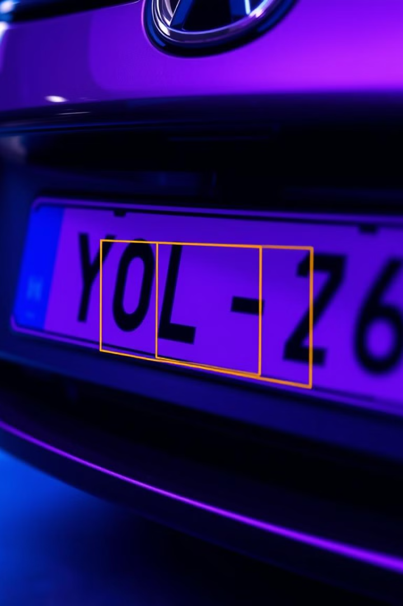
The Power of YOLOv8: Detecting Number Plates with Precision
1
Single-Stage Detection
2
Advanced Anchor-Free Design
YOLOv8 processes images in real time, making it ideal for ANPR applications where speed is crucial.
YOLOv8 excels at detecting small objects, such as number plates, even in complex scenes.
3
Transfer Learning
YOLOv8 leverages pre-trained weights for faster convergence, reducing training time and resources.

Slide 7
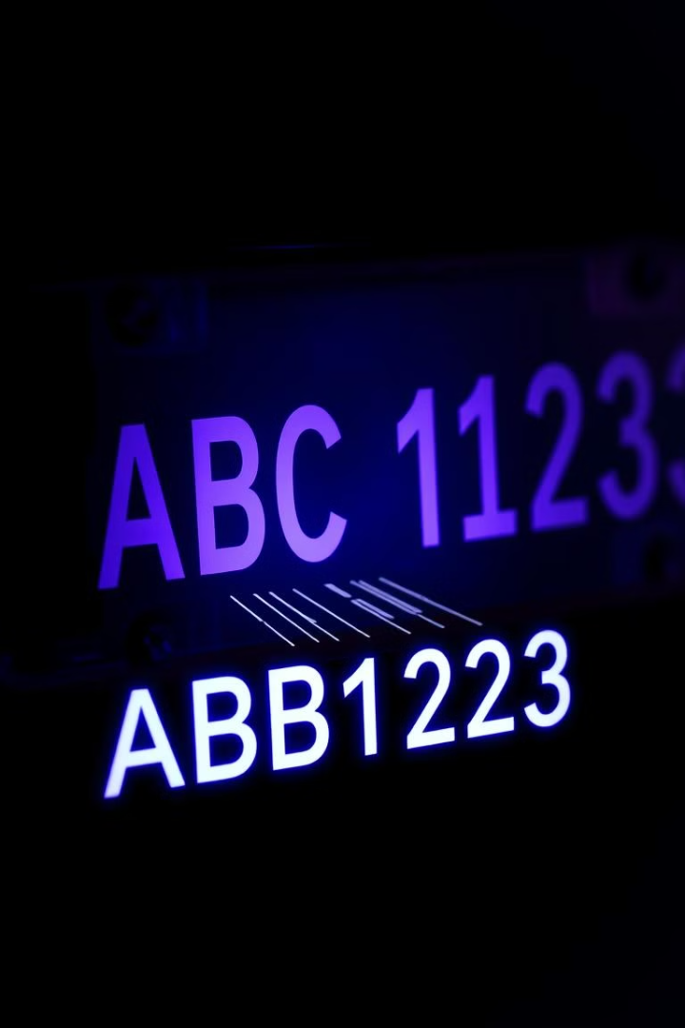


Extracting Text: The Role of PyTesseract in OCR
Post-Processing
Custom Preprocessing
Spell-checking and format validation enhance recognition accuracy.
Adaptive thresholding and morphological operations improve character clarity before OCR.

Slide 8
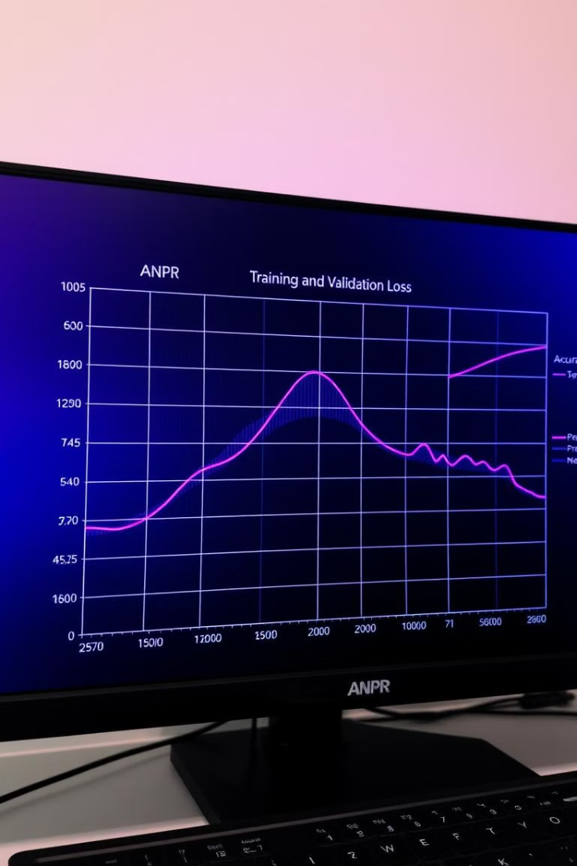
Training and Evaluation: Fine-Tuning for Optimal Performance
1
Training
The YOLOv8 model is fine-tuned using transfer learning, with parameters optimized for optimal performance.
2
Evaluation Metrics
Standard metrics, such as precision, recall, mean Average Precision (mAP), and OCR accuracy, are used to assess system performance.
3
End-to-End Evaluation
The overall system accuracy is computed as the product of detection and OCR accuracies, ensuring a comprehensive assessment.

Slide 9
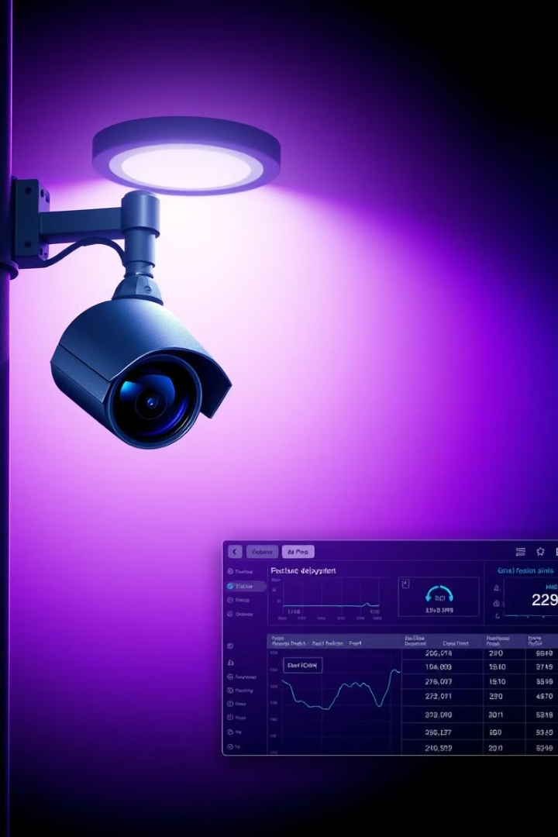



Deployment and Real-World Testing: Proving the System's Worth
Hardware Setup
The system is deployed on a powerful NVIDIA RTX 3060 GPU for real-time inference, ensuring seamless operation.
Test Scenarios
Performance is checked by testing the model at various times using the sample dataset.
Latency Measurement
Average detection and recognition latency are measured to ensure suitability for real-time applications.

Slide 10
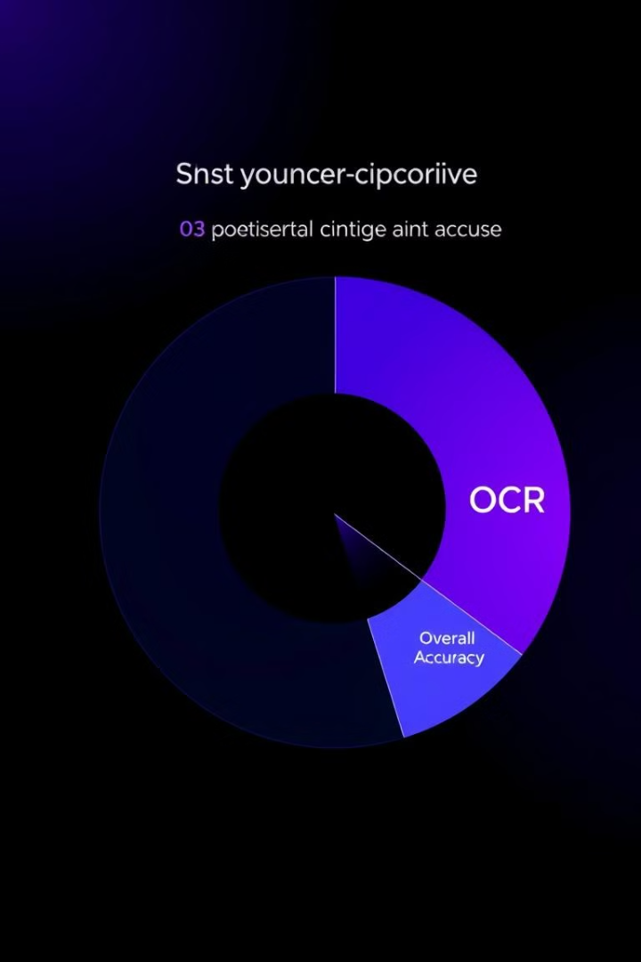
Impressive Results: Validation of the ANPR System
96.5%
Detection
The ANPR system achieves a remarkable 96.5% detection accuracy.
94%
OCR
PyTesseract delivers an impressive 94% accuracy in character recognition.
92%
Overall
Combining detection and OCR, the overall system accuracy reaches an impressive 92%.

Slide 11




Future Enhancements: Continuously Improving ANPR
Robustness
1
Addressing limitations in blurred or occluded plates.
Language Support
2
Extending OCR capabilities to handle multilingual plates.
Real-Time Deployment
3
Integrating the system with edge devices for on-site processing.
Advanced OCR Models
4
Exploring transformer-based architectures for improved recognition accuracy.

